Slide 1


DEPLOYMENT OF SERVICES IN AWS
M.Pavani

Slide 2
Deployment of an EC2 instance

Slide 3
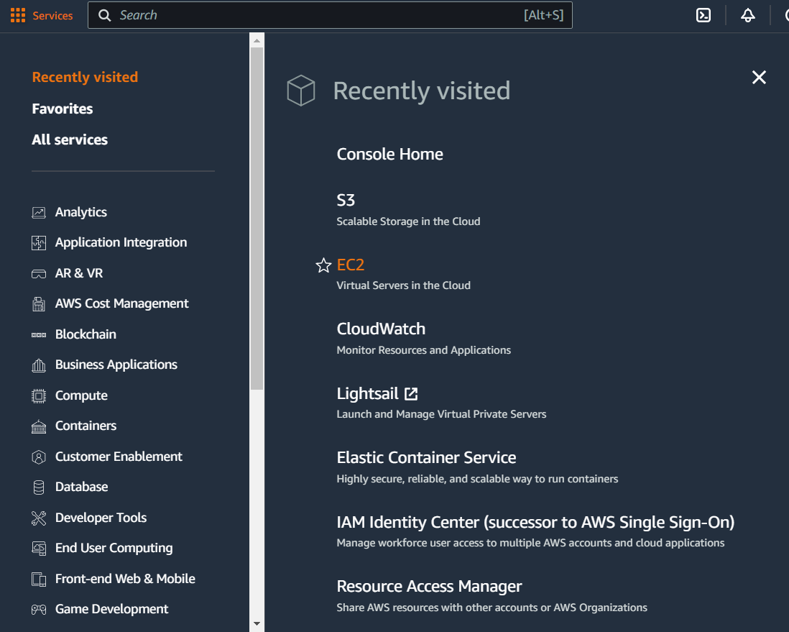
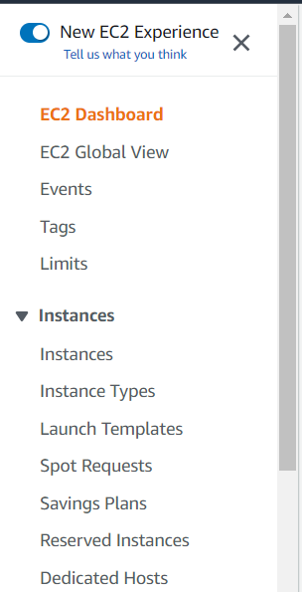
Step1: login to your aws account
Step2: From services tab select EC2
Step3: From the left navigation select instances

Slide 4
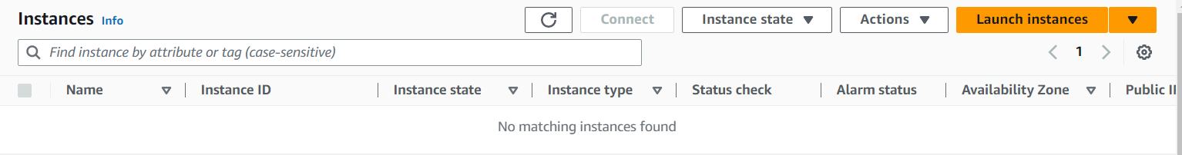
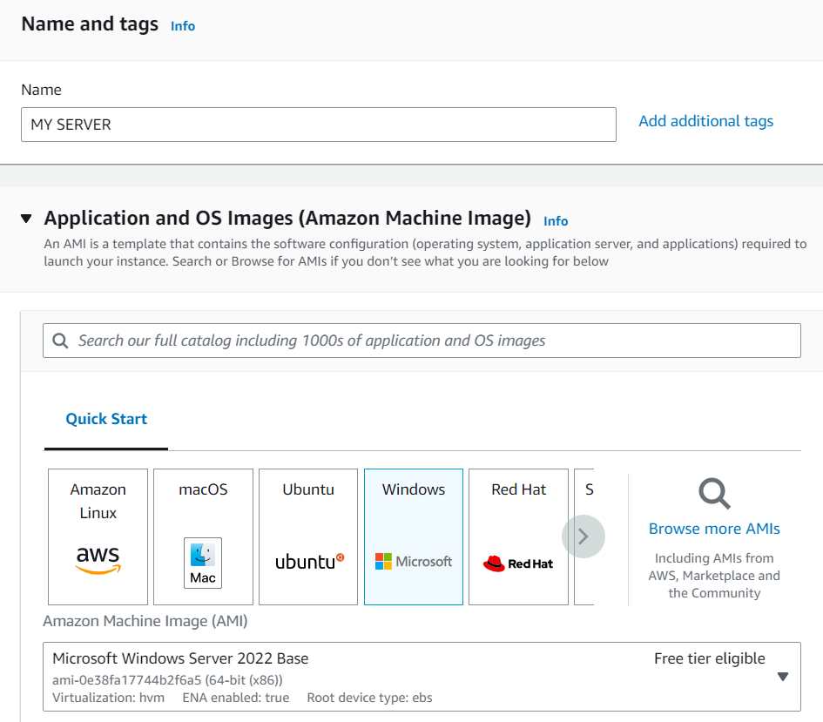
Step4: Now click on launch instances
Step5: Now provide the name and select the AMI(Amazon Machine Image) also and

Slide 5
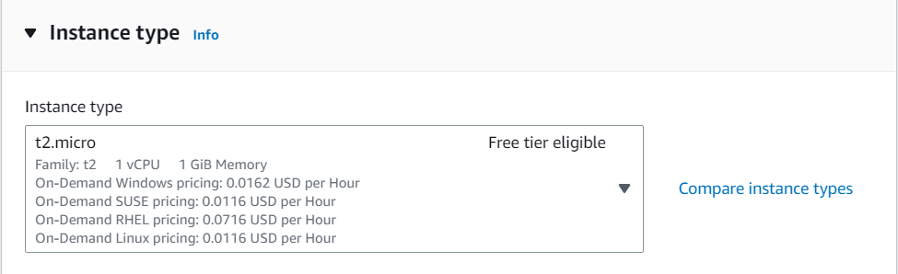
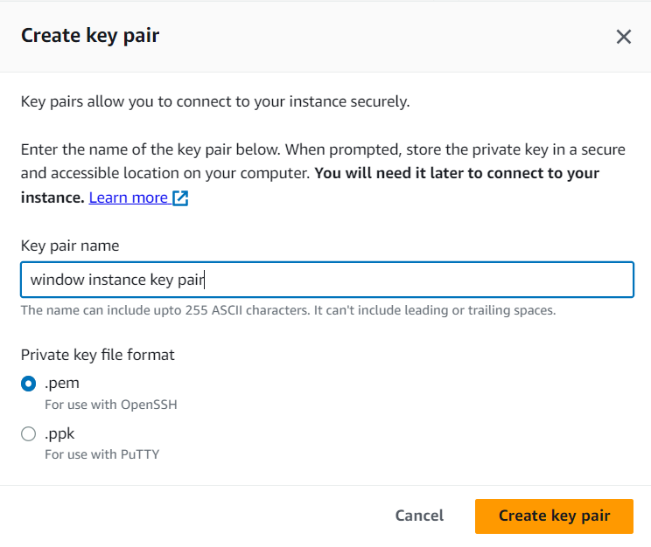
Step6: select the instance type
Step7: create a key pair for windows instances we need a .pem file whereas for Linux instances we need a ppk file

Slide 6
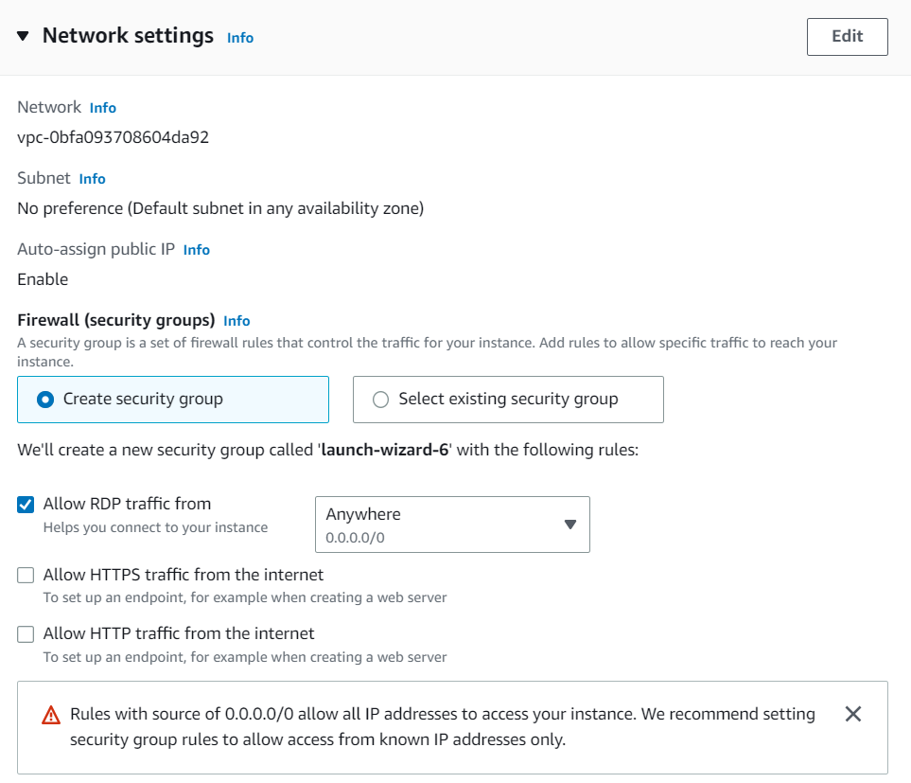
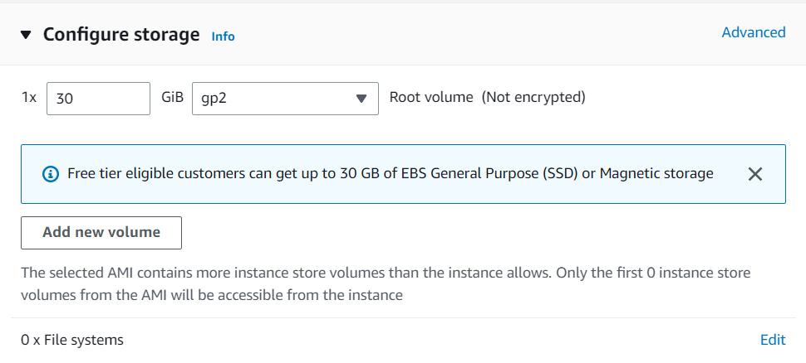
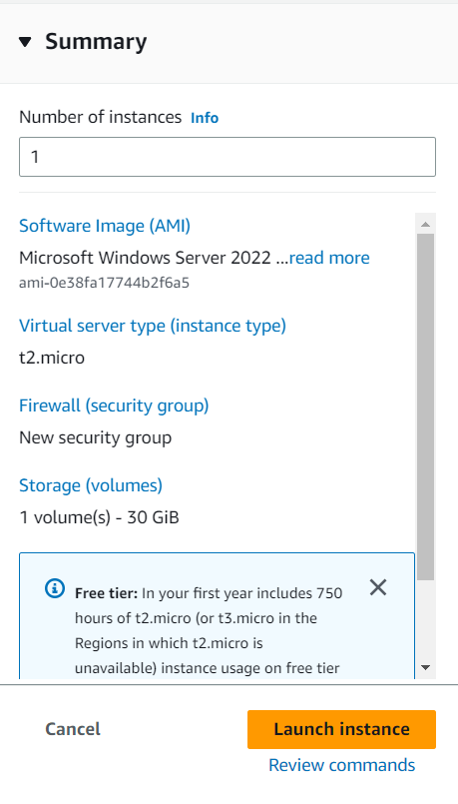
Step8: You may edit the network settings and storage as per your needs
Step9: Now click on launch instance

Slide 7
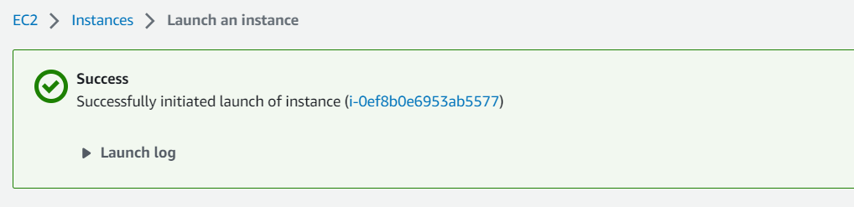
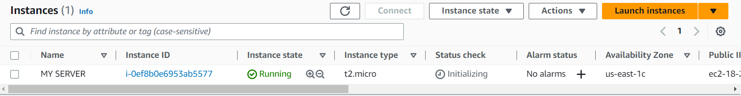
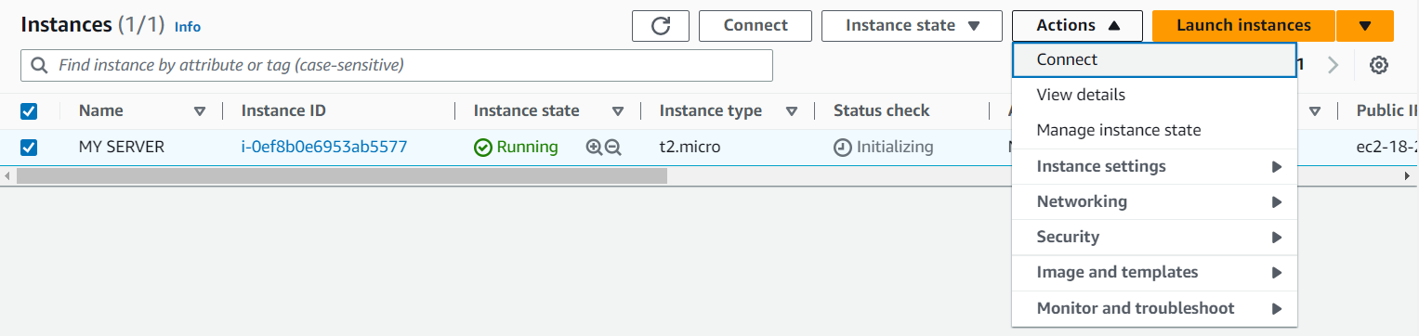
Step10: Now you will see that the instance is successfully launched ( this is for windows istance)
Step11: Now go back to the instances page and you will observe the instance launched by you will be in running state
Step12: Select the instance that is running and click on actions tap and click connect

Slide 8
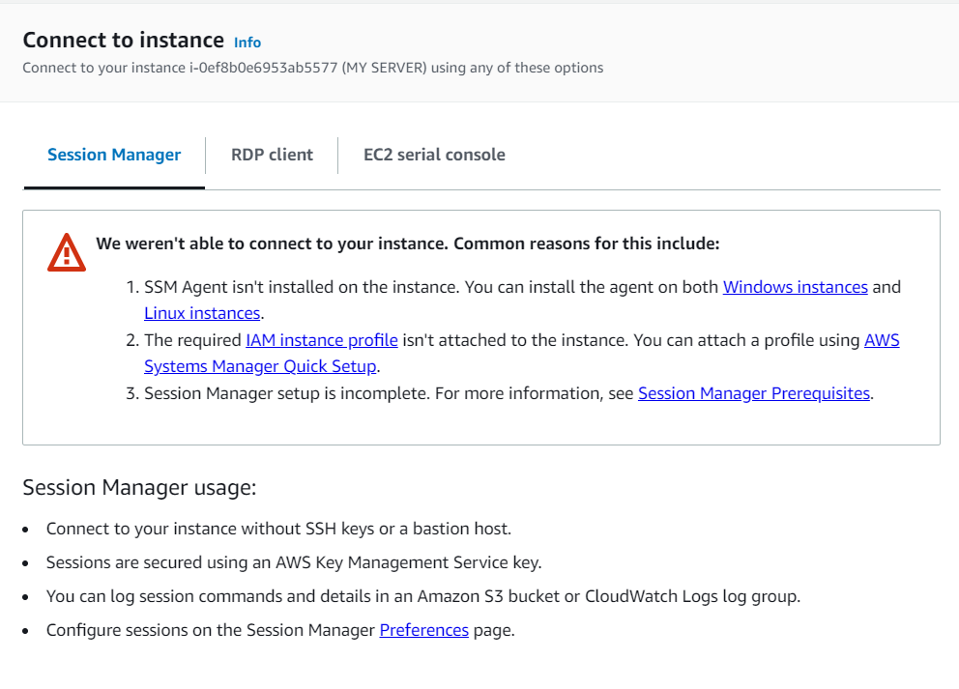
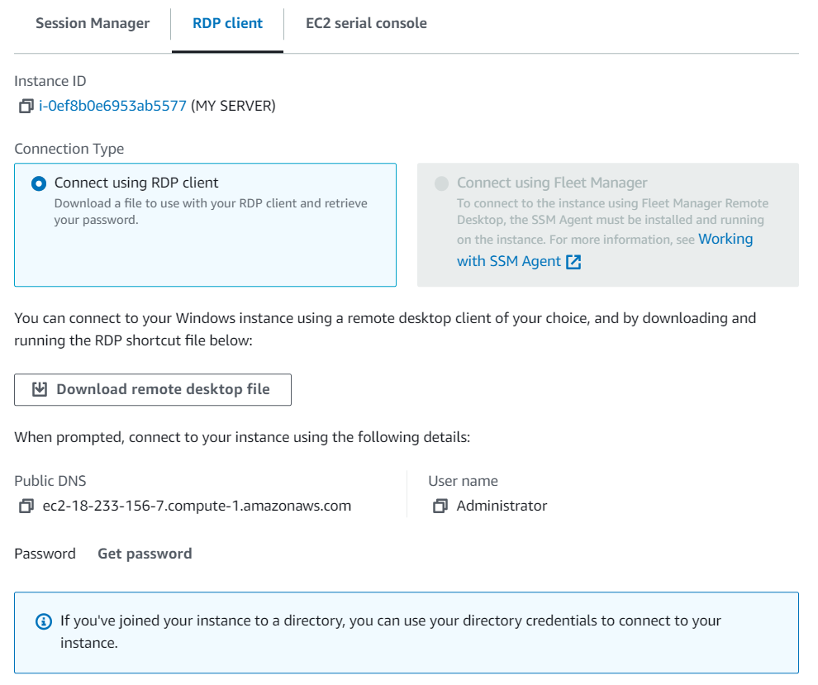
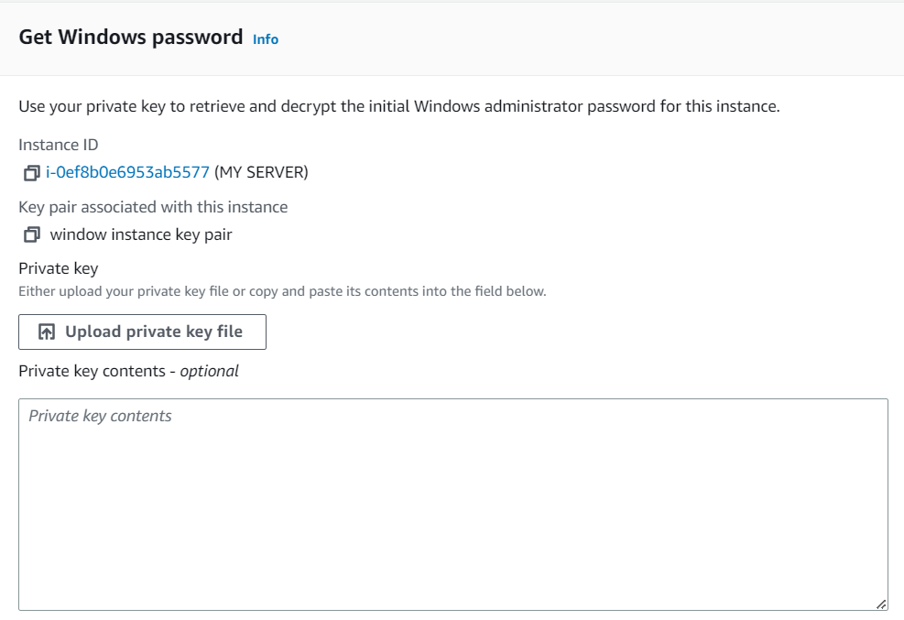
Step13: Now switch to rdp client and download the remote desktop file
Step14: Now click on get password and upload the private key file

Slide 9
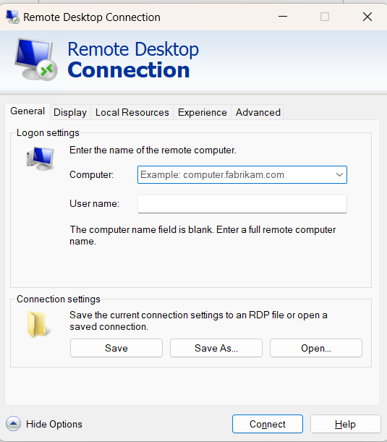
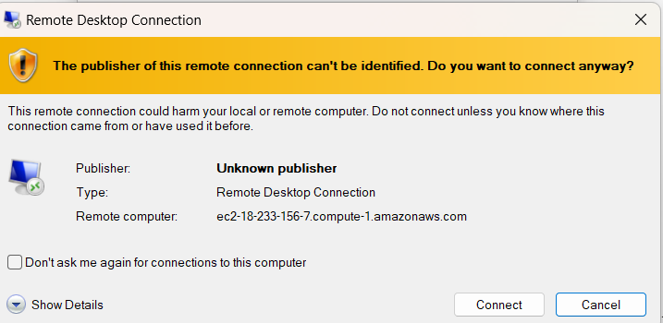
Step15:Now decrypt the password no you can connect the remote desktop in your pc by following the process
Windows +r
Then type mstsc and then enter
Then you will see a prompt as
Step16: Now provide the details and in connection select the remote desktop file that we downloaded earlier and then connect

Slide 10
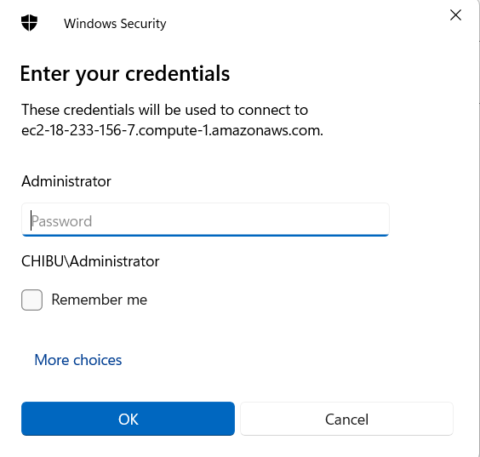
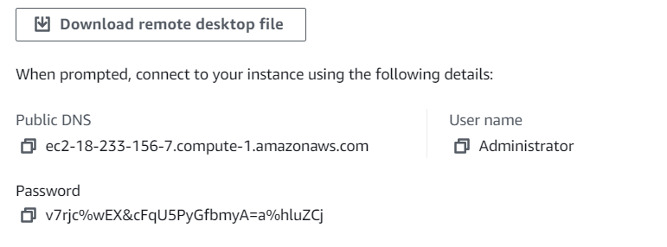
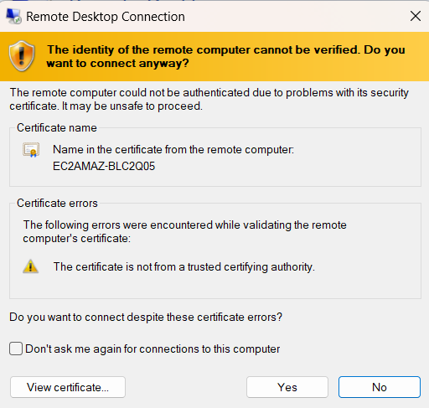
Step17: Once again click on connect
Step18: Now give the credentials i.e password and click on ok

Slide 11
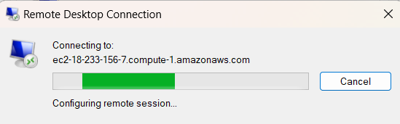
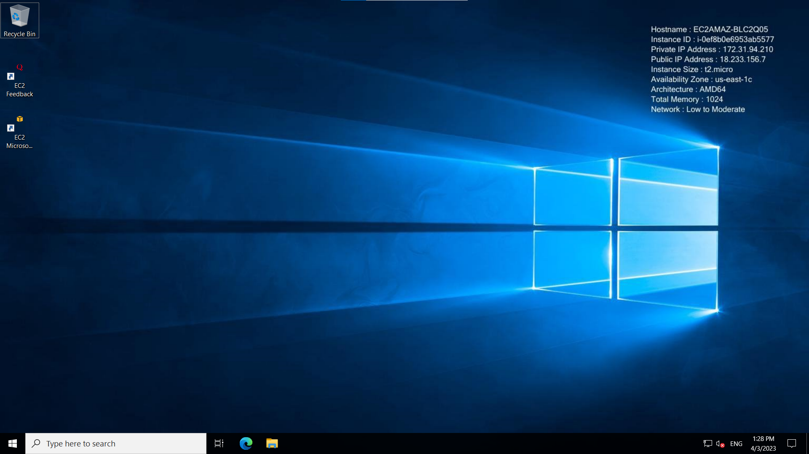
Step19: click on yes

Slide 12
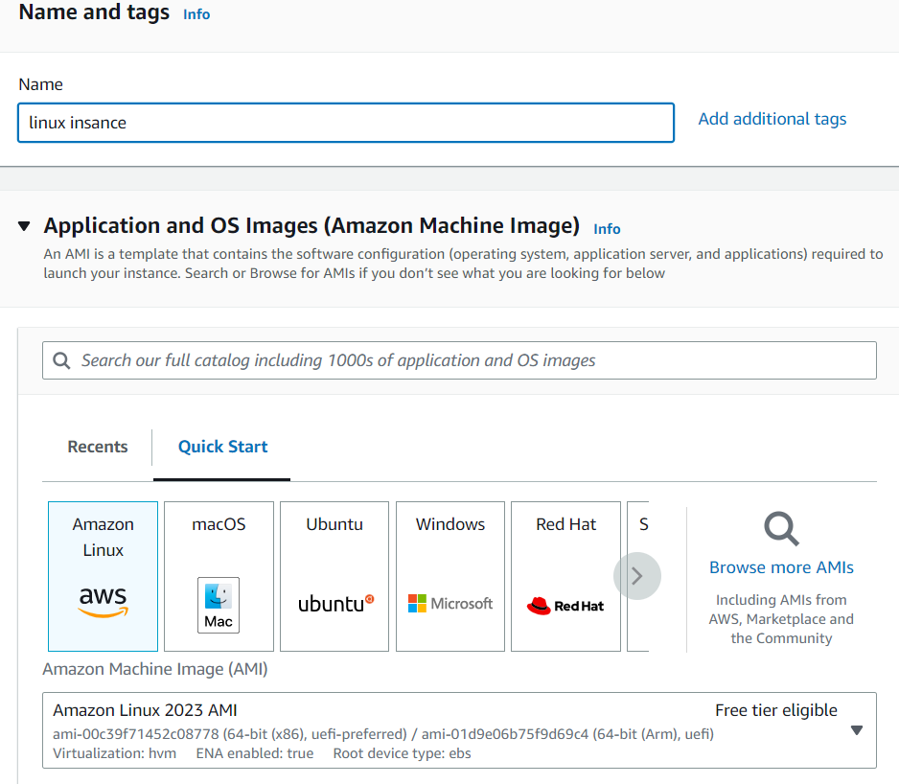
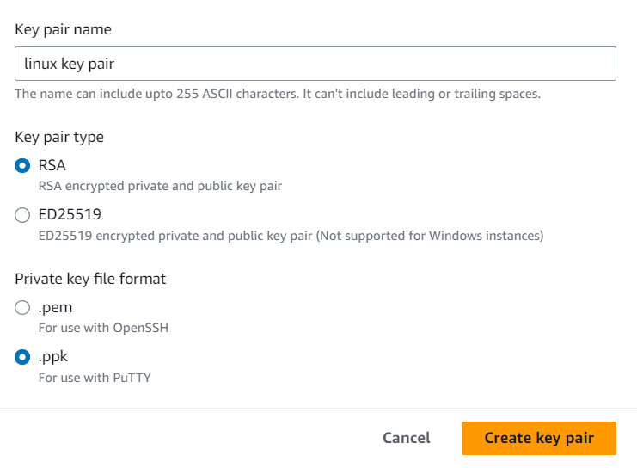
Step20: We are done connecting to EC2 instance
For Linux instances continue this from step10
The only change in the previous steps is instead of selecting windows AMI we need to select Amazon Linux AMI and while creating the key pair select .ppk file

Slide 13
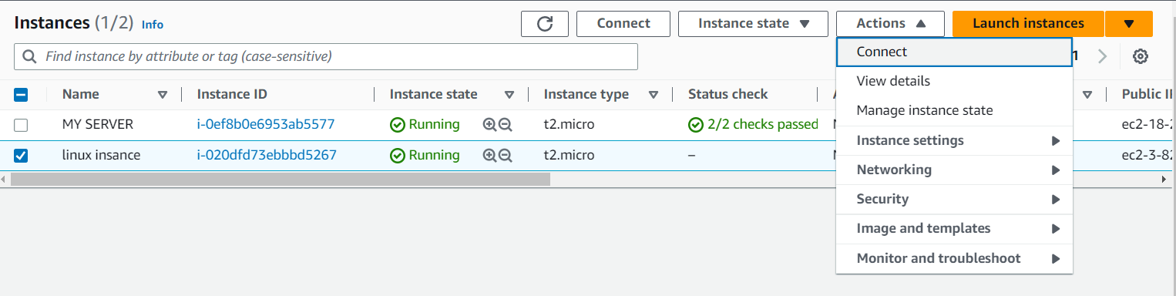
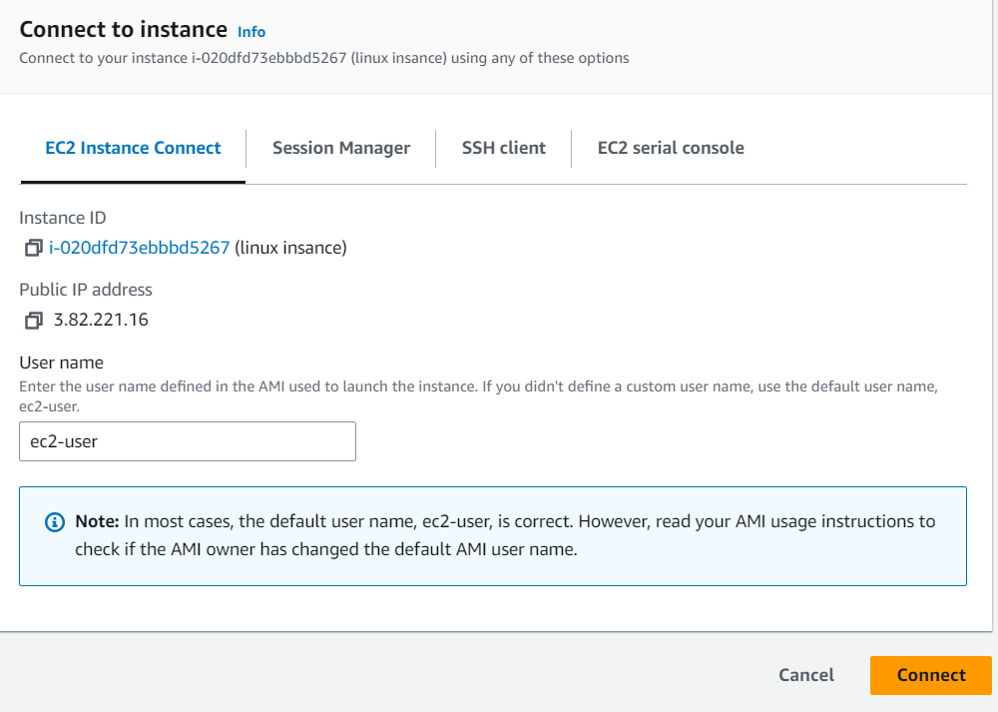
Step11: Select the linux instance click on actions and then connect
Step12: Click on connect

Slide 14
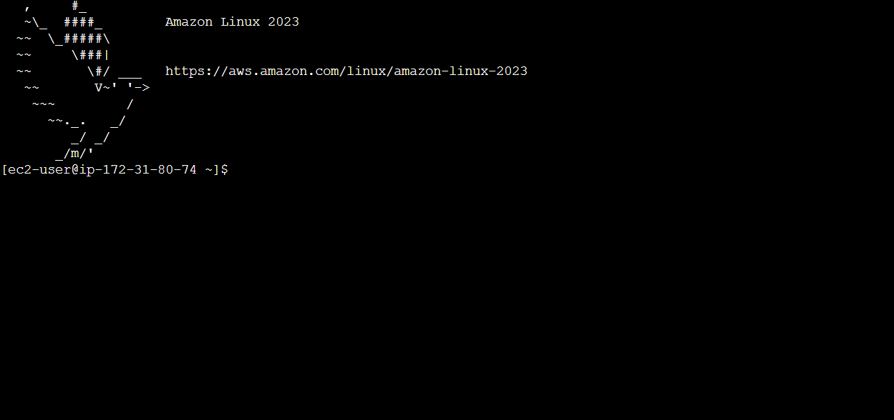
Step13: successfully connected

Slide 15
IAM(Identity Access Management)

Slide 16
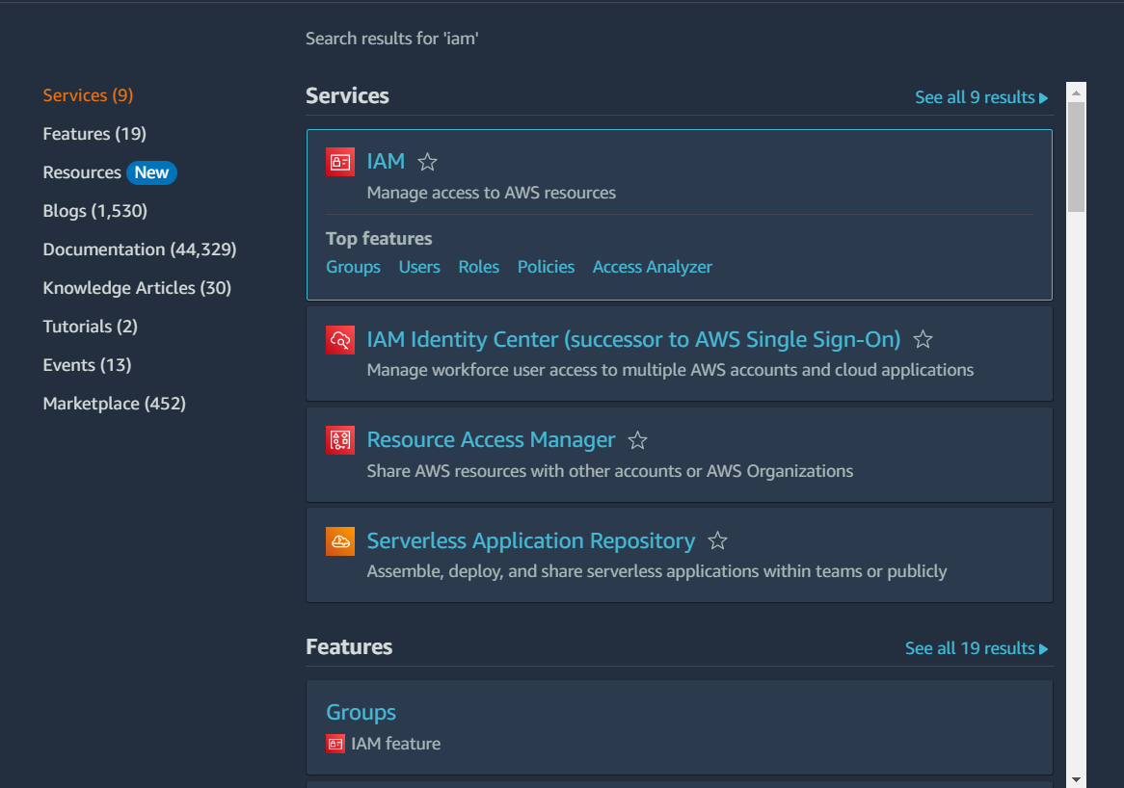
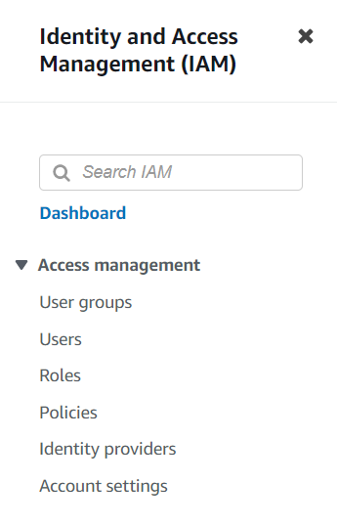
Step1: login to your AWS account
Step2: from services select IAM
Step3: From the left pane select users to create users

Slide 17
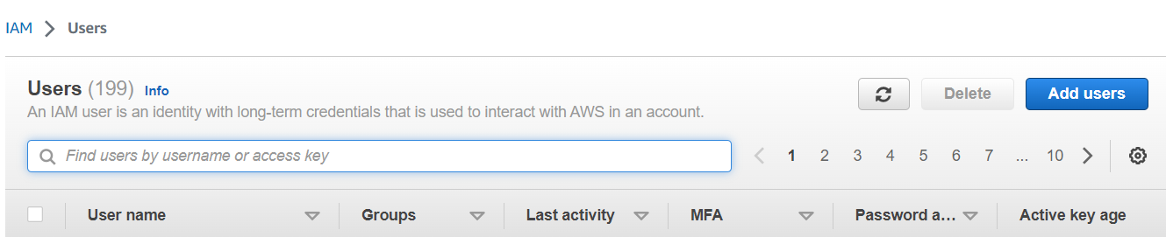
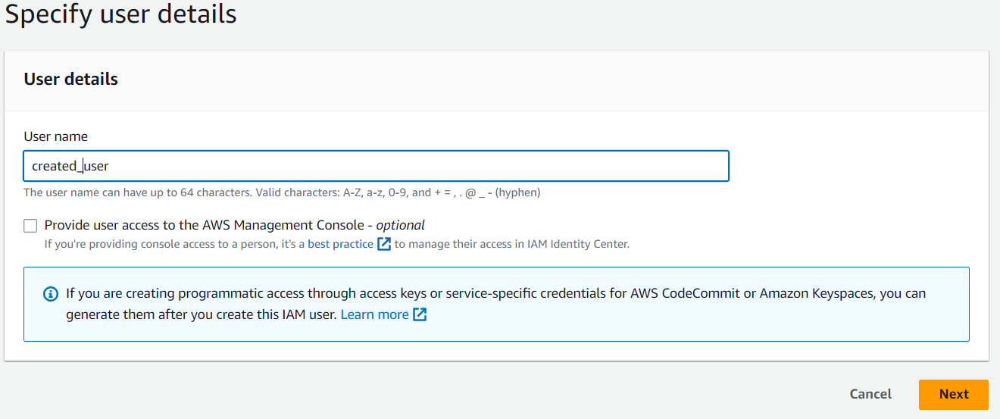
Step4: Now click on add users
Step5: Give the user name and click on next, next, and create user

Slide 18
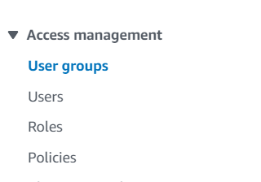
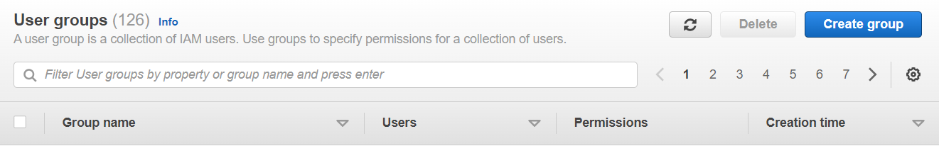
Step6: User successfully created message will be displayed
Step7: Now for creating groups from the left pane select
Step8: Click on create group

Slide 19
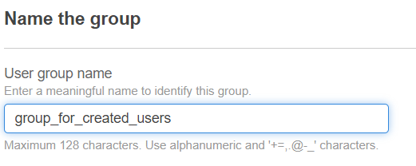
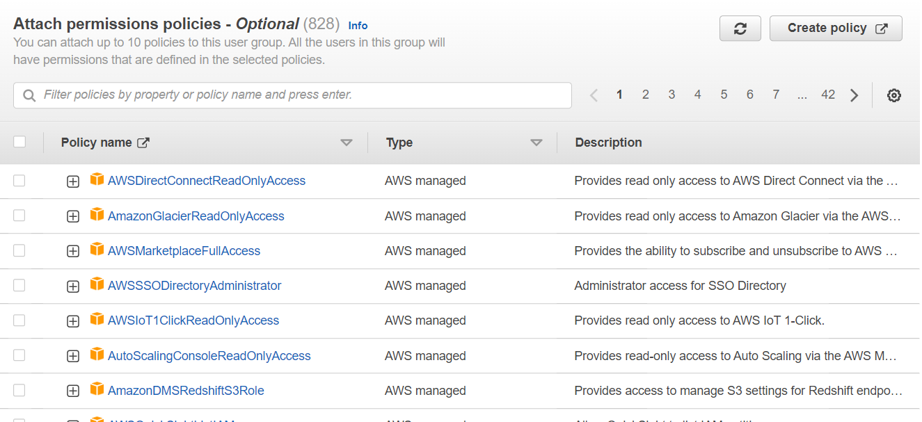
Step9: Now give the group name
Step10: attach the permissions that you want to give to users of the group you created

Slide 20
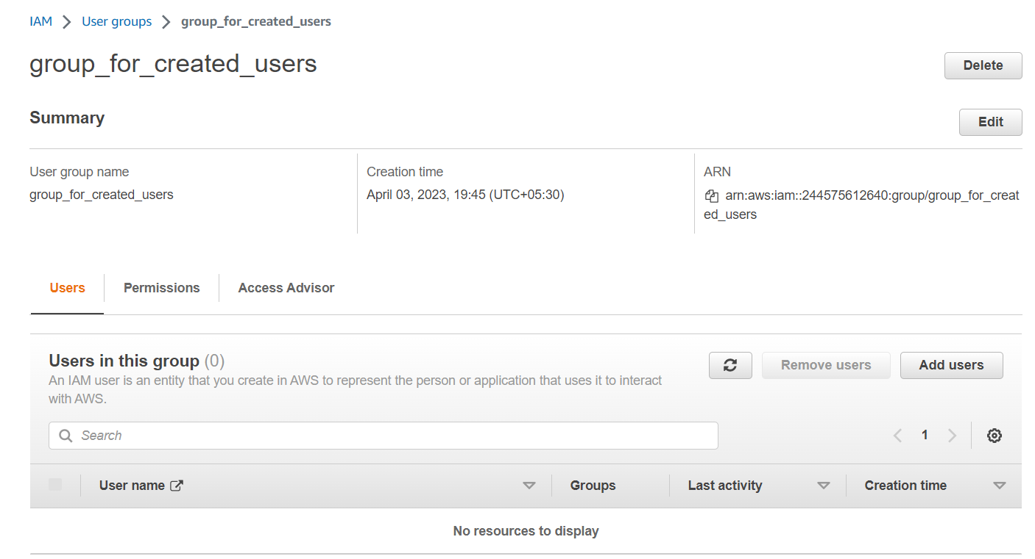

Step11: Now click on create group and then you will see a pop up for successful creation of group
Step12: Now you can add users to the group you created by clicking on add users

Slide 21
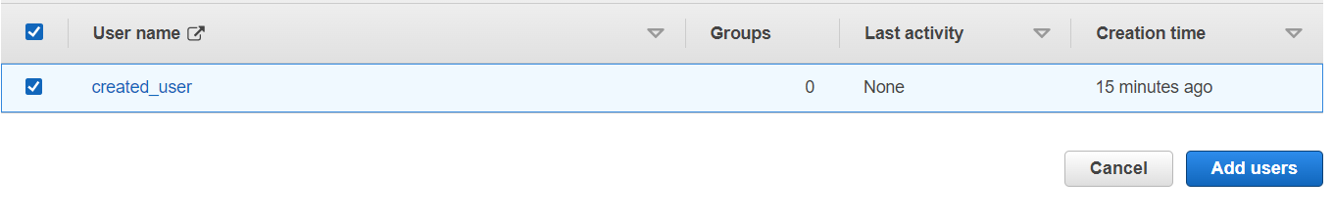
Step13: Now select the users you want to add into group and click on add users
Step14: Finally you will see the pop for successfully adding user to the group

Slide 22
Cloud watch

Slide 23
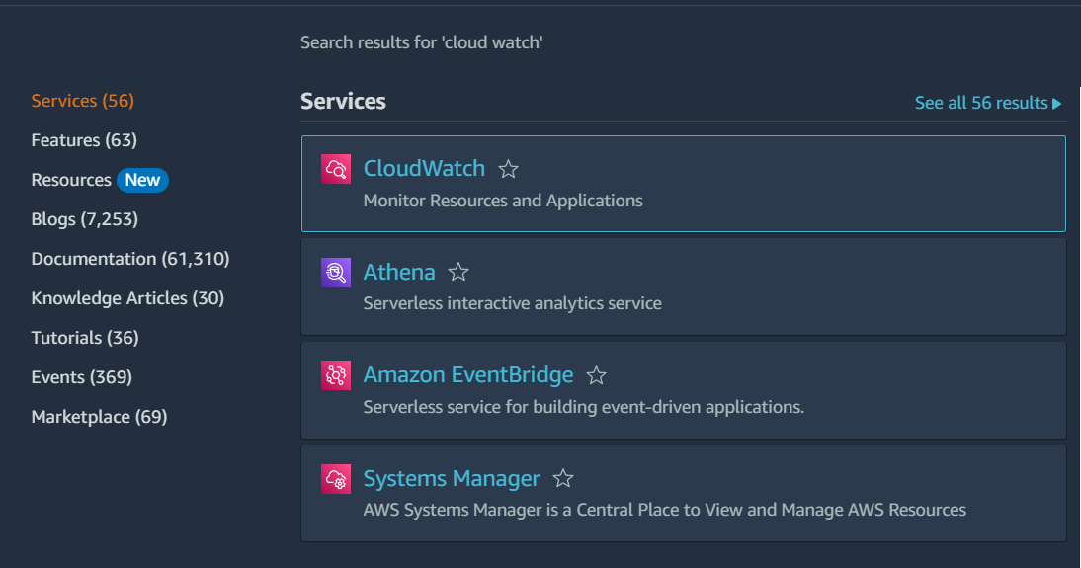
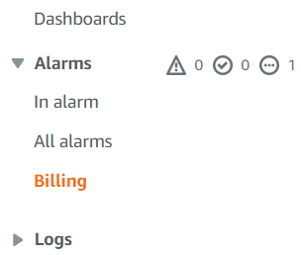
Step1: login to your AWS account
Step2: from services select cloud watch
Step3:From the dashboard on the left pane select billing

Slide 24
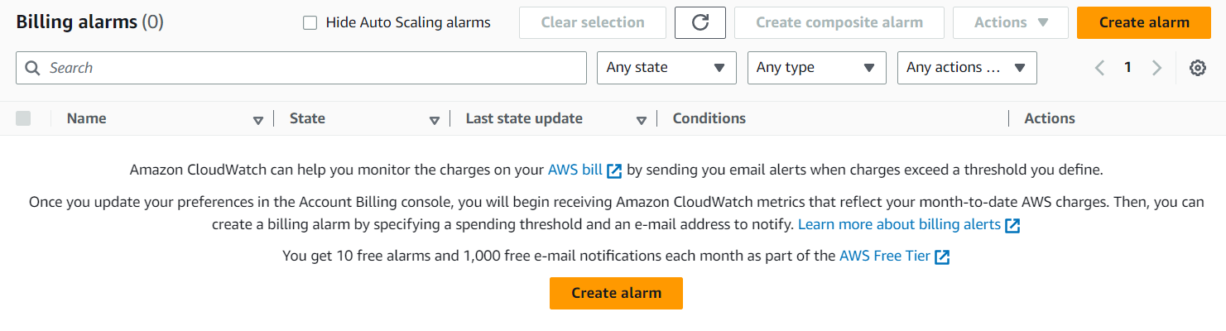
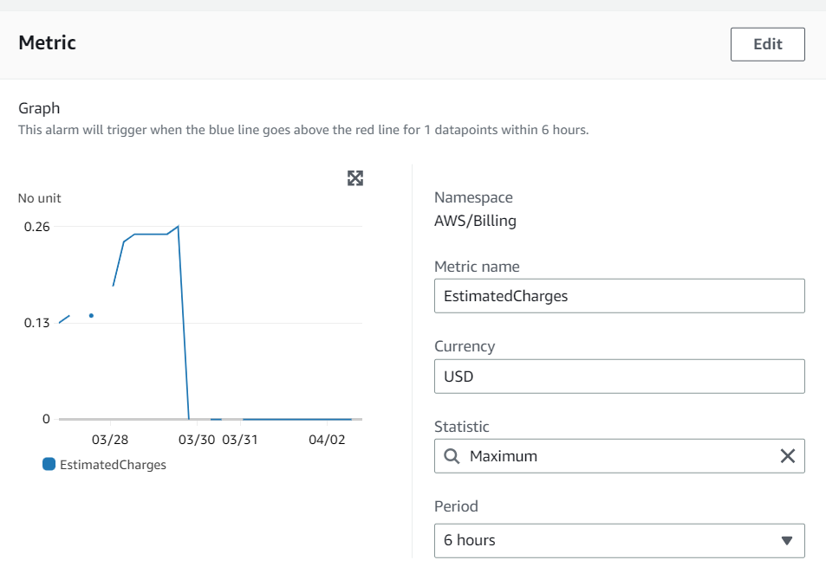
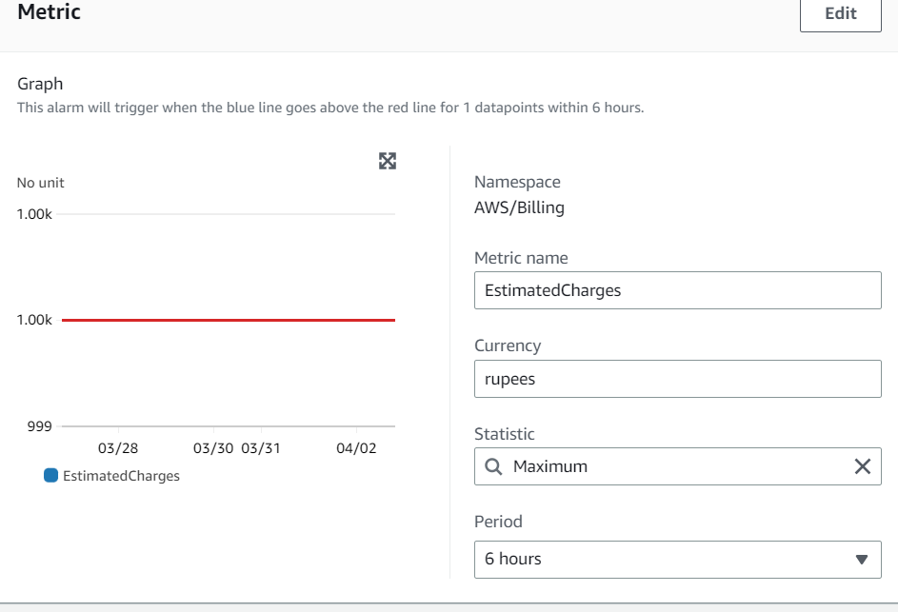
Step4: Click on create alarm
Step5: Now edit the metrics

Slide 25
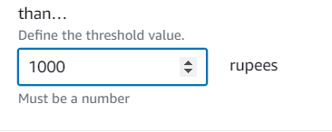
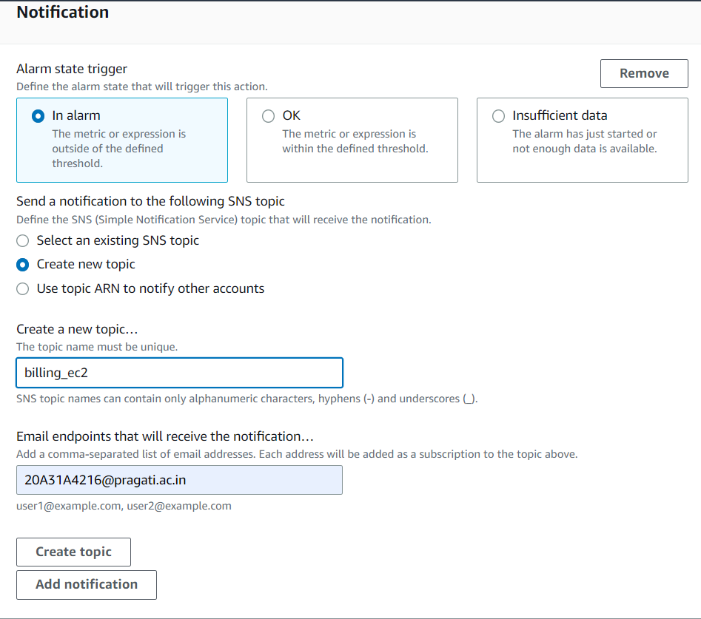
Step6: Now mention the amount for which if the billing crosses that particular amount it will send sms via sns i.e simple notification service
Step7: Now click on next
Step8: In the notification panel select create new topic give a name for topic and also provide the email to which you want the notifications to be enabled and then click on create topic

Slide 26
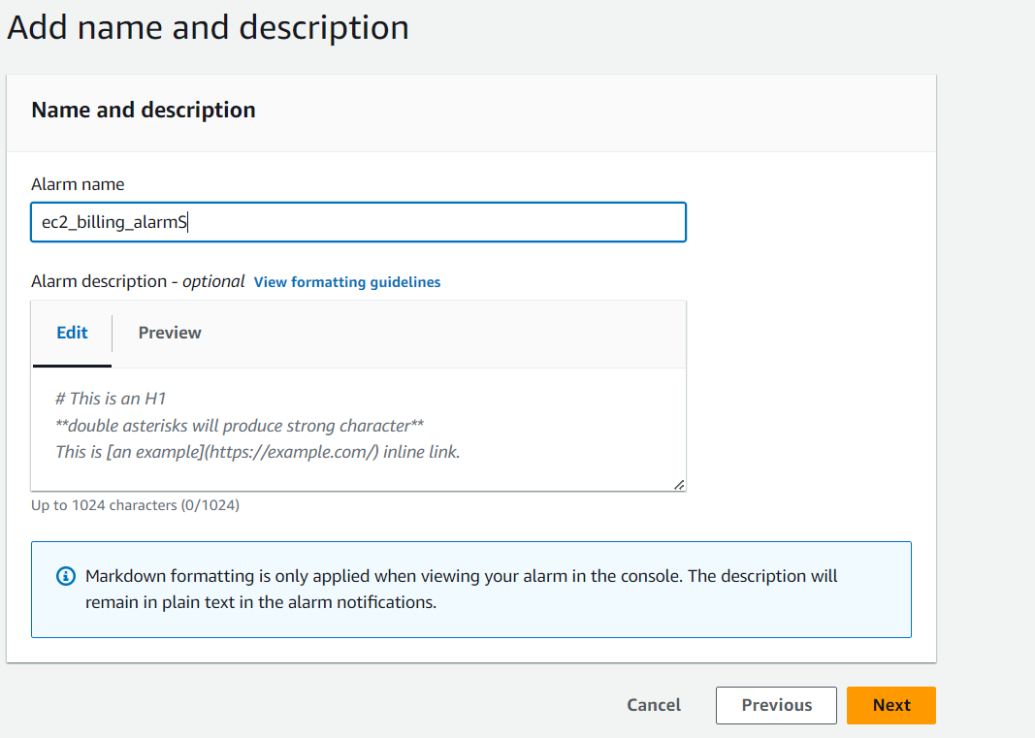
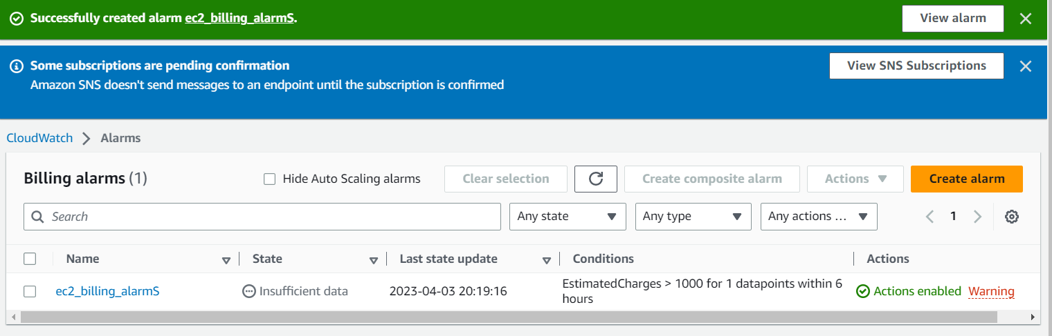
Step9: Now click on next
Step10: Give the alarm name and click on next and then create alarm
Step11: you will see the popup for successful creation of alarm

Slide 27
Virtual Private Cloud

Slide 28
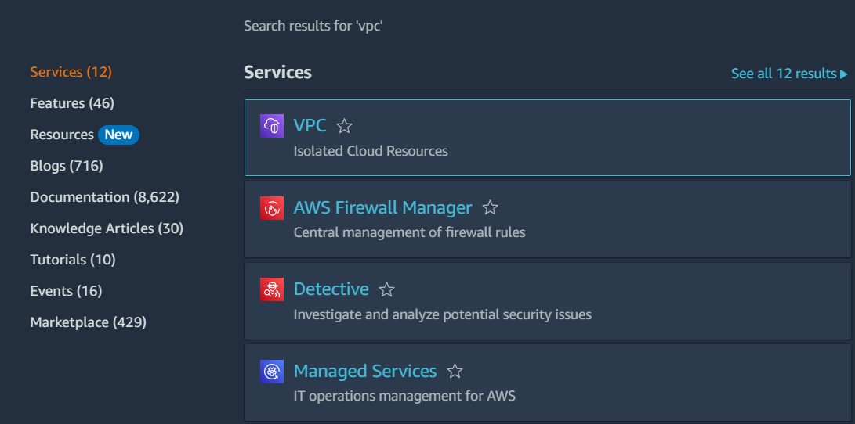
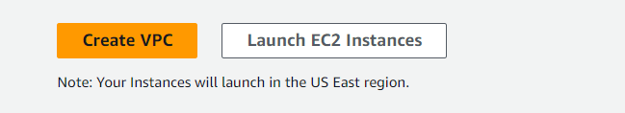
Step1: login to your aws account
Step2: from services select VPC
Step3: click on create VPC

Slide 29
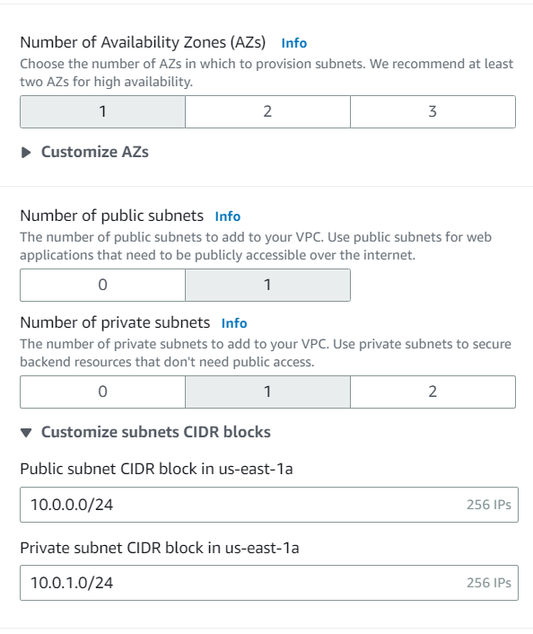
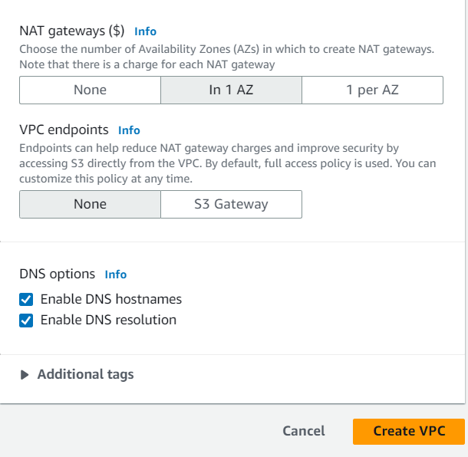
Step4: choose VPC and more
Step5:keep autogenerated selected and give the name for your VPC
Step6:for number of availability zones select 1
Step7: for the number of public subnets select 1
Step8: for the number of private subnets select 1
Step9: expand Customize subnets CIDR blocks and change the public subnet CIDR block in us-east-1a to 10.0.0.0/24 and change the private subnet CIDR block to 10.0.1.0/24
Step10: Set NAT gateways to In 1 AZ.
Step11:Set VPC endpoints to None.
Step12:Keep both DNS hostnames and DNS resolution enabled.
Step13: Now click on create VPC
Step14: click on view vpc

Slide 30

Step15:Now for creating subnets click on subnets from the dashboard and click on create subnet
Step16:
for VPC-ID select project-vpc
name the subnet
for availability zone select the second availability zone us-east-1b
And give the ipv4 CIDR block
Then click on create subnet
Step17: now create another subnet that is private subnet in the second availability zone using a similar approach

Slide 31

Step18:
In the left navigation pane, choose Route tables.
Select the project-rtb-private route table.
Choose the Subnet associations tab.
In the Explicit subnet associations panel, choose Edit subnet associations
Leave project-subnet-private1-us-east-1a selected, but also select project-private-subnet2.
Then click on save associations

Slide 32

Step19:
You will now configure the Route Table that is used by the Public Subnets.
Select the project-rtb-public route table (and deselect any other subnets).
Choose the Subnet associations tab.
In the Explicit subnet associations area, choose Edit subnet associations
Leave project-subnet-public1-us-east-1a selected, but also select project-public-subnet2.
Then click on save associations

Slide 33

Step20:
In the left navigation pane, choose Security groups.
Choose Create security group and then configure:
Give a name to the security group
Description: Enable HTTP access
VPC: from the drop-down list choose project-vpc
reate security group

Slide 34

Step21:
In the Inbound rules pane, choose Add rule
Configure the following settings:
Type: HTTP
Source: Anywhere-IPv4
Description: Permit web requests
Scroll to the bottom of the page and choose create security group C

Slide 35
Step21:
Now create an amazon linux EC2 instance
while creating configure the network settings
Select the network as project-vpc
Select the project-private-subnet2 as subnet
And enable auto assign ip
Under firewall select the existing security group and select the created security group i.e security
In the Configure storage section, keep the default settings.
Launch the instance

Slide 36
Elastic Block Store

Slide 37


Step1:login to your AWS account
Step2:from services select EBS
step3:create an EC2 instance
Step4: from the left pane select volumes
Step5:click on create volume

Slide 38


Step6:Edit the volume settings Specifying that select the same availability zone that we used while creating EC2 instance
Step7:Give the tag key and value then create volume

Slide 39

Step8:Now after creation of volume click the actions tab and click on attach volume

Slide 40

Step9:Now provide the name of the instance that we created in step 3 and click on attach volume
Step10:Volume attached successfully

Slide 41
THANK YOU

